Slide 1
Overview of UCAT and Academic thresholds in recent academic cycles
YEAR OF ENTRY | 2021​ | 2022​ | 2023​ | 2024​ | 2025​
Average National UCAT Score​ | 2511​ | 2570​ | 2500​ | 2516​ | 2523​
A100 Core Interview Threshold​ | 2820​ | 2800​ | 2820​ | 2490​ | ​ Total Academic Score: 50 (Out of 100)
A100 Contextual Interview Threshold​ | 2720​ | 2719​ | 2700​ | 2490​ | ​ Total Academic Score: 50 (Out of 100) ​
A101 Interview Threshold​ | 3030​ | 3010​ | 2930​ | 2820​ | 2740​
International Interview Threshold​ | 2820​ | 2870​ | 2600​ | 2910​ | 2980​

Slide 2
2025 entry - data of candidates offered an interview
 | Widening Participation | Core
Overall academic score (GCSE/A-levels plus UCAT) Out of 100 | Mean 70 (range 50-100) | Mean 82 (range 50-100)
Points from GCSE/A-level Out of 40 | Mean 34 (range 16-40) | Mean 37 (range 19-40)
Points from UCAT Out of 60 | Mean 36 (range 10-60) | Mean 45 (range 10 -60)
Lowest UCAT= 10 points - equivalent to getting 1900 in 2025’s scoring system
Lowest GCSE = 16 points - equivalent to getting 4 x grade 6s, and 4 x grade 7s

Slide 3
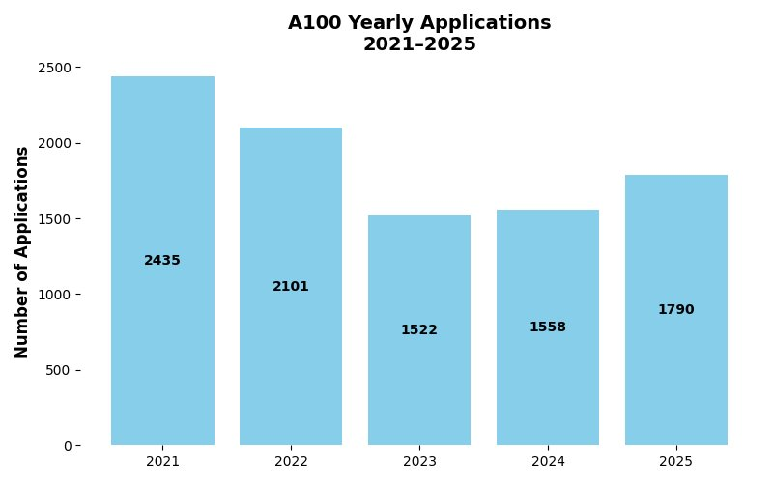
Overview of A100 application numbers in recent academic cycles

Slide 4
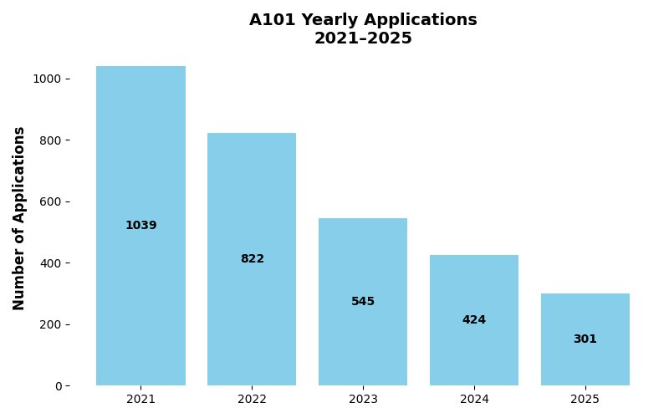
Overview of A101 application numbers in recent academic cycles

Slide 5
For 2026 Entry
Home applicants can achieve a total score of up to 100 points, made up of:
i. Academic score (maximum 40 points): Based on grades from most recent set of qualifications, except for those applying with an Access to HE qualification or an honours degree.
ii. UCAT score (maximum 60 points): Awarded based on UCAT performance.
Widening Participation and PARTNERS students will be assessed separately from Core applicants in all parts of the selection process.
For all international applicants and all A101 applicants, following the screen for achieved or predicted academic results, UCAT score will form the sole basis for ranking and selection for interview.
UCAT ANZ will be accepted for applicants applying to UK, partner consortium and Australian/New Zealand consortium universities.

